Slide 1
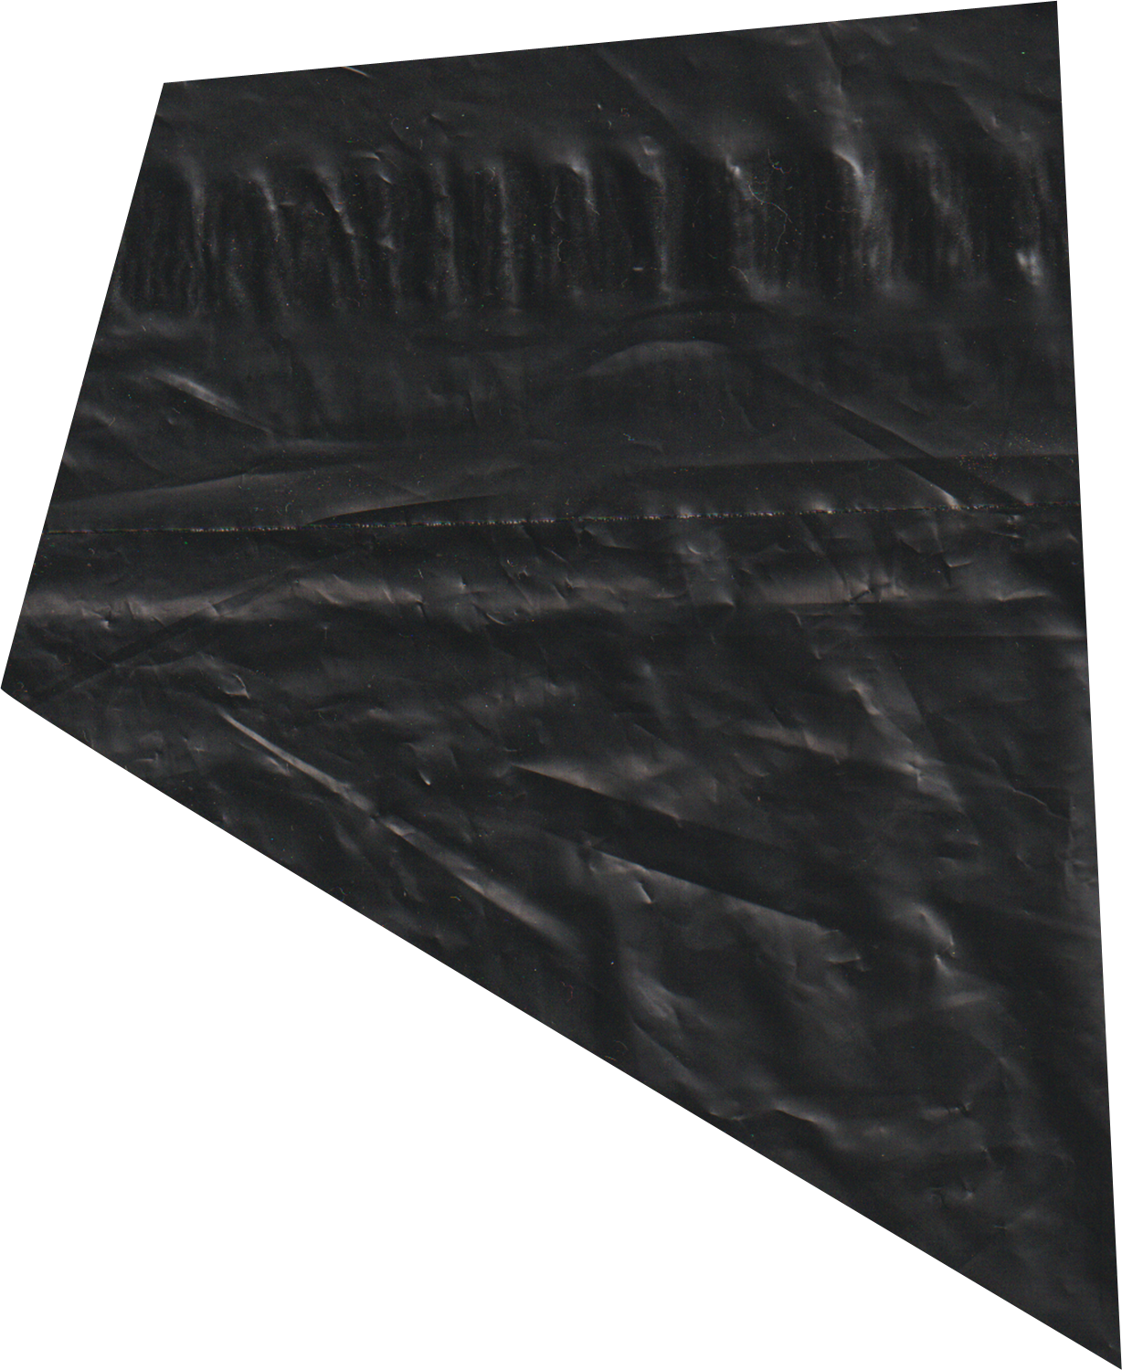
Meat Classifier
Meera Ameera

Slide 2
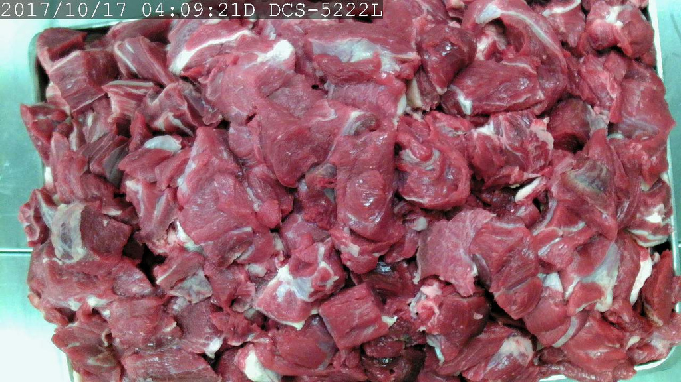
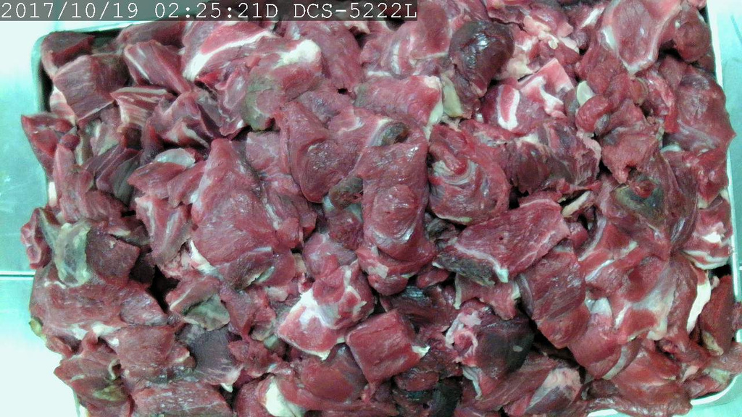
Fresh
Spoiled
Introduction
Meat spoilage is a major concern in food safety and supply chain management.
Identifying fresh vs spoiled meat accurately can help prevent health risks and reduce food waste.
The meat appears bright red.
There are minimal discolorations or dark spots, meaning it has not undergone spoilage.
The surface of the meat looks drier or slimy.
The spoiled meat has darker patches and a greenish or brownish tint.

Slide 3
Data Exploration & Pre-processing
Dataset Splitting
Implemented a function (split_and_copy) to split the dataset into training, validation, and testing subsets using scikit-learn’s train_test_split.
Training Set (70%)
Validation Set (20%)
Testing Set (10%)
Dataset Distribution
Plotted a bar graph showing the number of images per class in each subset.
There is a balanced distribution across the 3 subsets.
Visualize Sample Images
Used matplotlib to find out the dimensions of the images in the dataset.
(720, 1280, 3)

Slide 4
Data Exploration & Pre-processing
Data Augmentation
Applied ImageDataGenerator to augment training images, improving model generalization.
Rotation (±5°)
Width & Height Shifting (10%)
Zooming (±10%)
Horizontal Flipping
Brightness Adjustments (0.8 - 1.2)
Shear Transformations & Channel Shifting
Image Pre-processing
Normalized pixel values to the [0,1] range using rescale=1./255 to standardize input.
Data Pipeline Implementation
Resized images to 224×224 for compatibility with pre-trained models.
Mapped class labels numerically and visualized sample batches.

Slide 5
Baseline Model
Transfer Learning
Model Architecture
CNN-based model with three convolutional layers and max-pooling.
Used ReLU activation and softmax for classification.
Applied L2 Regularization & Dropout to prevent overfitting.
Compilation & Training
Used Adam optimizer and categorical cross-entropy loss.
Implemented Early Stopping to stop training if validation loss stops improving.
Trained for 30 epochs.
Model Architecture
Loaded pre-trained CNN model without top layers.
Froze base model layers to retain pre-learned features.
Used ReLU activation and softmax for classification.
Applied Global Average Pooling, Batch Normalization, L2 Regularization and Dropout.
Compilation & Training
Used Adam optimizer and categorical cross-entropy loss.
Implemented Early Stopping to stop training if validation loss stops improving.
Trained for 25 epochs.

Slide 6
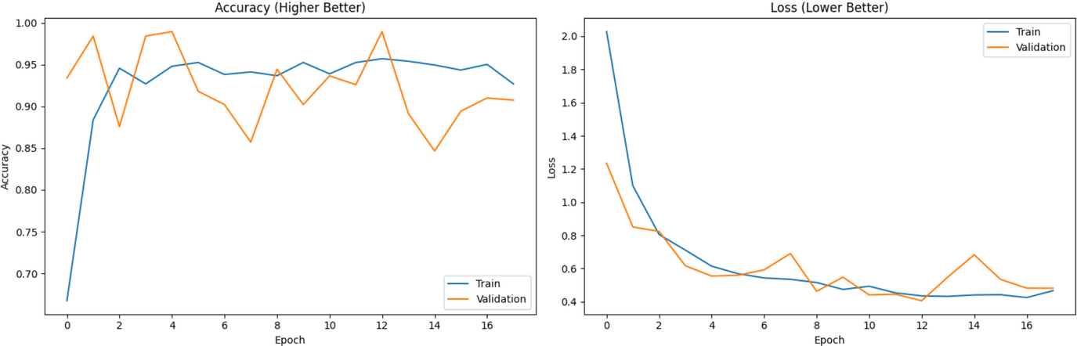
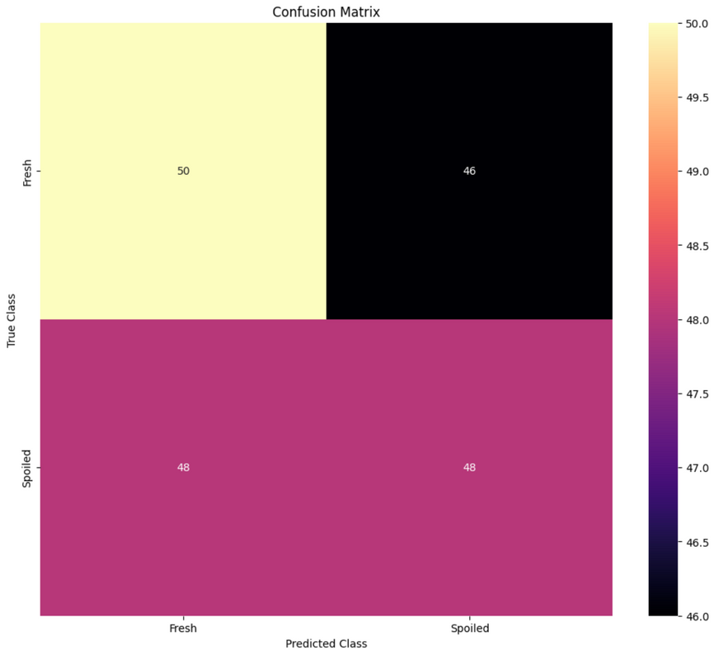
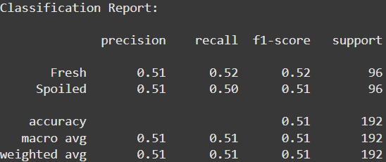
Baseline Model
Results
High test accuracy (97.92%) and low test loss (0.38).
However, the confusion matrix shows high misclassification rates between Fresh and Spoiled classes.
Classification Report Insights shows both classes have balanced but relatively low precision and recall (~0.51 for both), indicating the model struggles with identifying both Fresh and Spoiled items effectively.

Slide 7
Plans for Improvement
Although my baseline model achieved a high accuracy score, the confusion matrix and classification report indicated signs of overfitting poor generalization, leading to many misclassifications.
Reduce Overfitting & Improve Generalization
Improve Confusion Matrix & Classification Report
Optimize Hyperparameters & Model Selection
Use pre-trained models with frozen lower layers to leverage learned features.
Apply stronger regularization techniques.
Enhance data augmentation to expose the model to diverse conditions.
Fine-tuning specific layers in the pre-trained model.
Use class weights to ensure fair learning across categories.
Experiment with different base models (Inception, MobileNet, ResNet, EfficientNet, or VGG) and compare performance.
Implement grid search or manually fine-tune batch size, dropout, and learning rate.

Slide 8
Transfer Learning Results
InceptionV3
MobileNetV2
ResNet50
Model Performance
The model demonstrates strong generalization, with a high test accuracy (97.92%) and low test loss (2.45), showing good generalization to unseen data.
Training & Validation Trends
While the training accuracy steadily improves, the validation accuracy stabilizes around 94%.
Confusion Matrix Analysis
The model has high accuracy, with only 4 misclassifications (3 Fresh as Spoiled, 1 Spoiled as Fresh).
Classification Report Insights
The precision, recall, and F1-scores are all very high for both classes with minimal false positives or false negatives. The overall accuracy (98%) shows that the model can classify both Fresh and Spoiled meat with a strong level of reliability.
Model Performance
The model shows poor performance, with both low accuracy and high loss, indicating that it is struggling to generalize well on the test set.
Training & Validation Trends
The model is overfitting on the training data, showing good learning but failing to generalize effectively to the validation set.
Confusion Matrix Analysis
The model is biased towards predicting the Fresh class and performs poorly on the Spoiled class (9 Spoiled as Fresh), indicating a severe class imbalance.
Classification Report Insights
The model has high precision for the Spoiled class but poor recall and F1-score for Fresh class, leading to imbalanced performance and showing that it fails to predict Spoiled meat correctly most of the time.
Model Performance
The model demonstrates strong generalization, with a high test accuracy (95.83%) and low test loss (1.24), showing good generalization to unseen data.
Training & Validation Trends
Training Accuracy consistently improves, reaching close to 1 but there are some fluctuations in validation accuracy.
Confusion Matrix Analysis
The model is performing well overall, with only a few misclassifications (7 Fresh as Spoiled, 1 Spoiled as Fresh).
Classification Report Insights
The precision, recall, and F1-scores are all very high for both classes with minimal false positives or false negatives. The overall accuracy (96%) shows that the model can classify both Fresh and Spoiled meat with a strong level of reliability.
InceptionV3

Slide 9
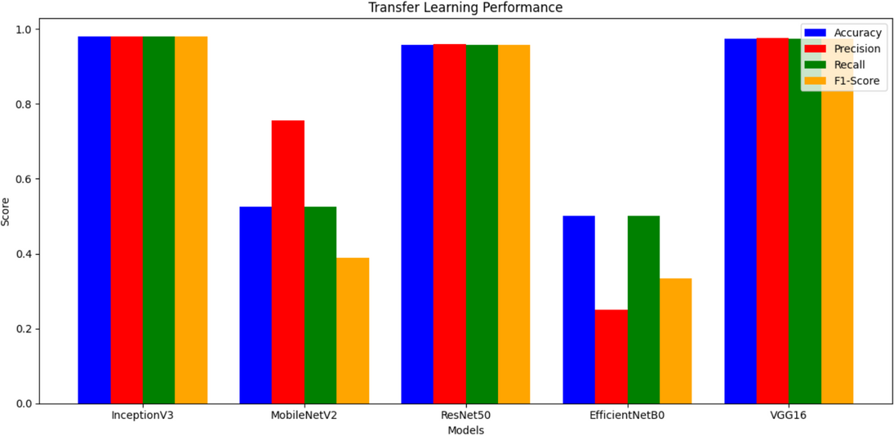
Transfer Learning Results
EfficientNetB0
VGG16
Model Performance
The model shows poor performance, with a low test accuracy (50.00%) and high test loss (2.86), suggesting that it struggles to generalize well to unseen data.
Training & Validation Trends
While training accuracy improves, validation accuracy remains stagnant at 50%, suggesting the model is overfitting to the training data and not generalizing well unseen examples.
Confusion Matrix Analysis
The model is biased towards predicting the Fresh class and performs poorly on the Spoiled class, indicating a severe class imbalance.
Classification Report Insights
While precision for the Spoiled class is high (1.00), the recall is alarmingly low (0.05), meaning the model is unable to correctly identify most spoiled meat instances.
Model Performance
The model demonstrates strong performance with a high test accuracy (97.51%) and a low test loss (1.34), showing good generalization to unseen data.
Training & Validation Trends
The training accuracy improves steadily, while validation accuracy remains high and stabilizes above 98%.
Confusion Matrix Analysis
The model has high accuracy, with only 4 misclassifications (5 Fresh as Spoiled).
Classification Report Insights
The precision, recall, and F1-scores are all very high for both classes with minimal false positives or false negatives. The overall accuracy (97%) shows that the model can classify both Fresh and Spoiled meat with a strong level of reliability.
Chosen models to fine-tune:
InceptionV3
ResNet50
VGG16

Slide 10
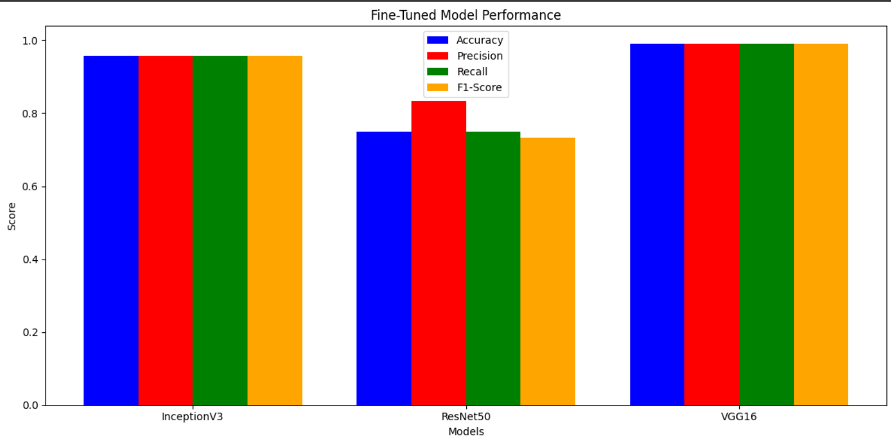
FINE-TUNING ANALYSIS
Model Architecture
Unfroze the last 20 layers to allow the model to learn new features specific to the target task.
Compilation & Training
Used the Adam optimizer with a reduced learning rate for fine-tuning.
Set class weights to address class imbalance between Fresh and Spoiled classes.
Implemented Early Stopping to stop training if validation loss stops improving.
Trained for 15 epochs.

Slide 11
Chosen Model (VGG16)
Model Performance
Shows high generalization with strong prediction accuracy on unseen data.
Training & Validation Trends
Fine-tuning improved model accuracy, with validation accuracy reaching 99.47% and a steady decrease in loss.
The gap between the validation accuracy and training accuracy is small, suggesting that the model is not overfitting significantly.
Confusion Matrix
Only 2 Fresh instances were misclassified as Spoiled.
Highest accuracy in identifying both Fresh and Spoiled meat
Classification Report Insights
The precision, recall, and F1-scores are all very high for both classes with minimal false positives or false negatives. The overall accuracy (99%) shows that the model can classify both Fresh and Spoiled meat with a strong level of reliability.
Conclusion
The fine-tuned VGG16 model demonstrates excellent performance and reliability, making it an ideal especially for deployment in food safety monitoring systems.

Slide 12
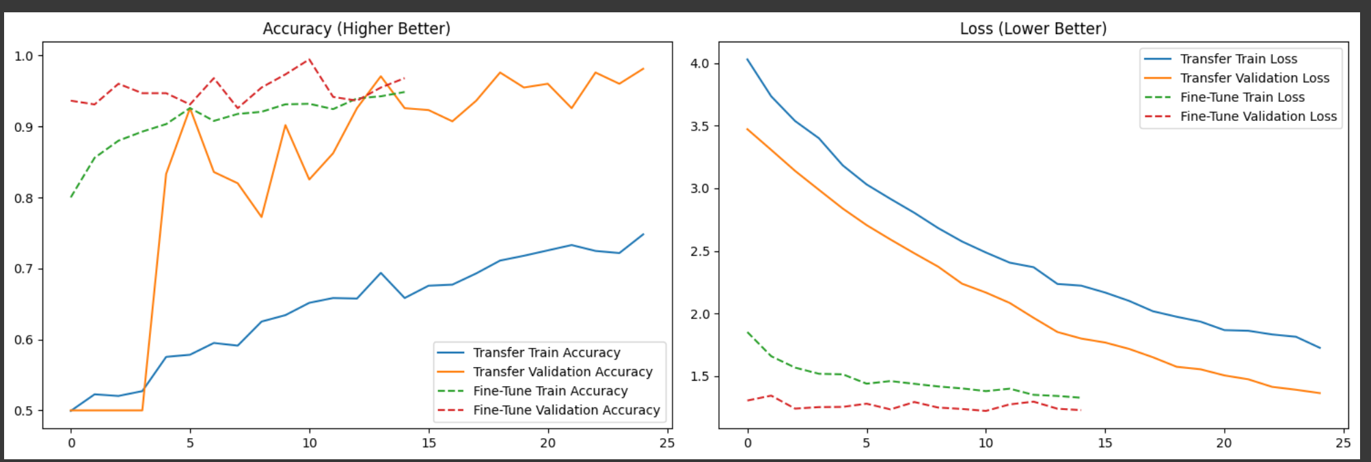
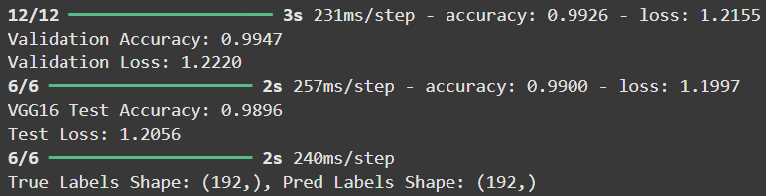
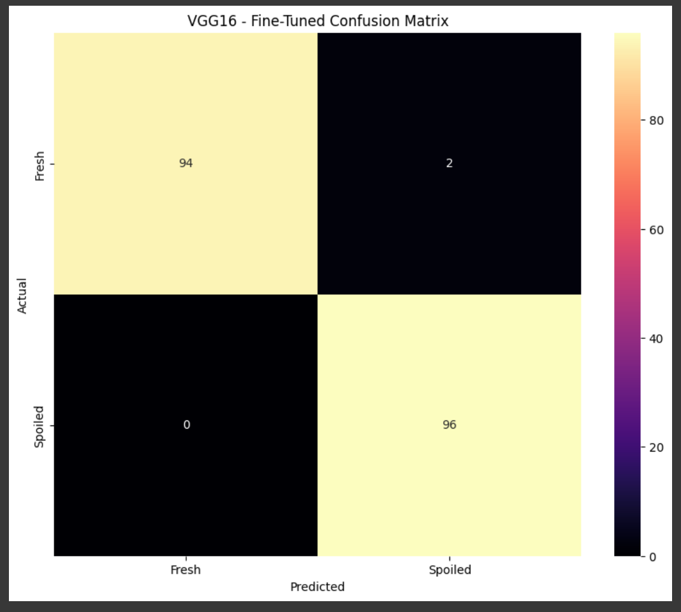
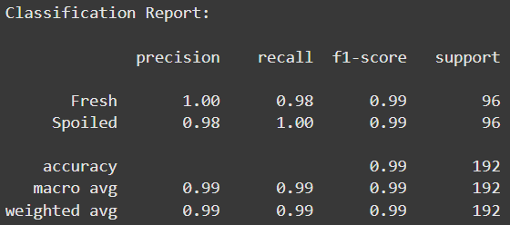

Slide 13
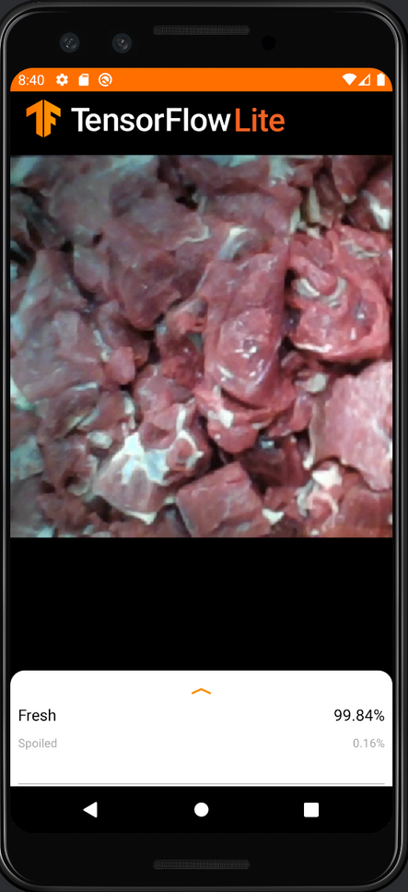

ANDROID DEPLOYMENT

